Slide 1



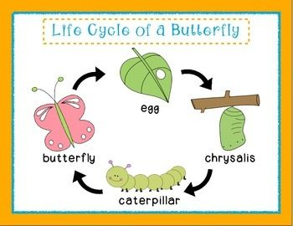
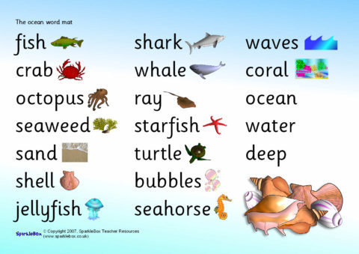
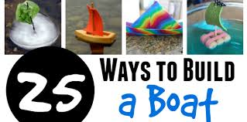
Land Ahoy!
Topic Questions
Geography: What is an Island?
History: How did people travel long distances to different countries in the past?
Science: What is a habitat?
DT: How did you build your boat?
Art: What did you do to create a wave in your picture?
PSED: What is a first aid kit?

Slide 2
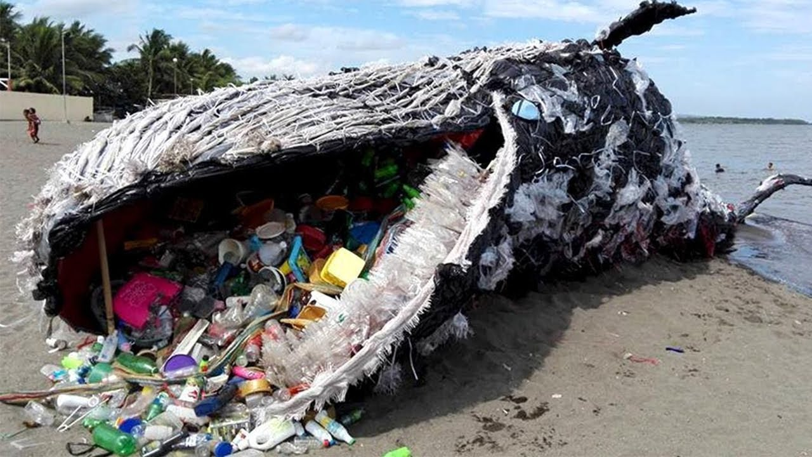
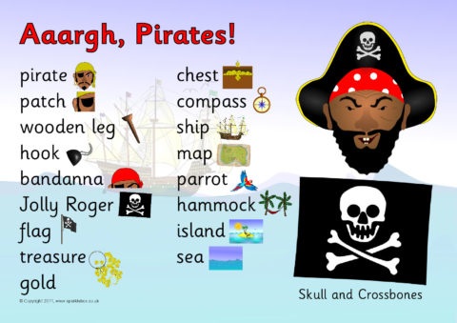
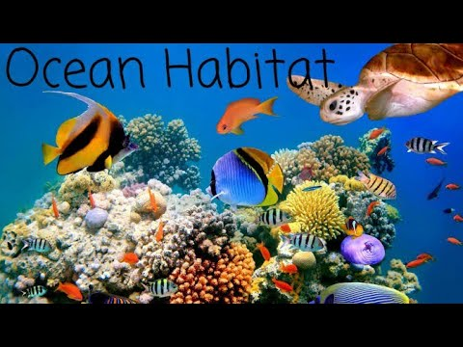
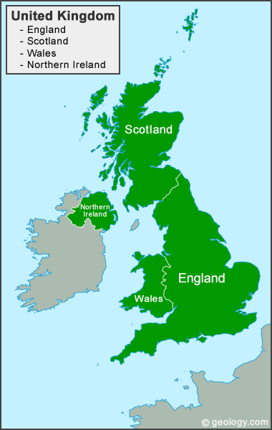
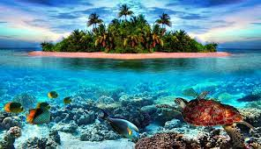

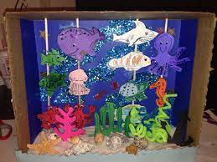
Homework Topic Tasks
Build a boat that can float. How many lego people can fit on your boat?
Make a poster on how you can help stop ocean pollution.
Draw 6 living and non living things you can find in your house/garden?
Make a clay/playdough model of your favourite sea creature.
Draw, label and write some facts about your favourite sea creature.
Create an under the sea diorama.
How can you combat ocean pollution?
Can you make an under the sea diorama?
Can you name some living and non living things?
You live on an Island too!
A tropical Island.

