Slide 1
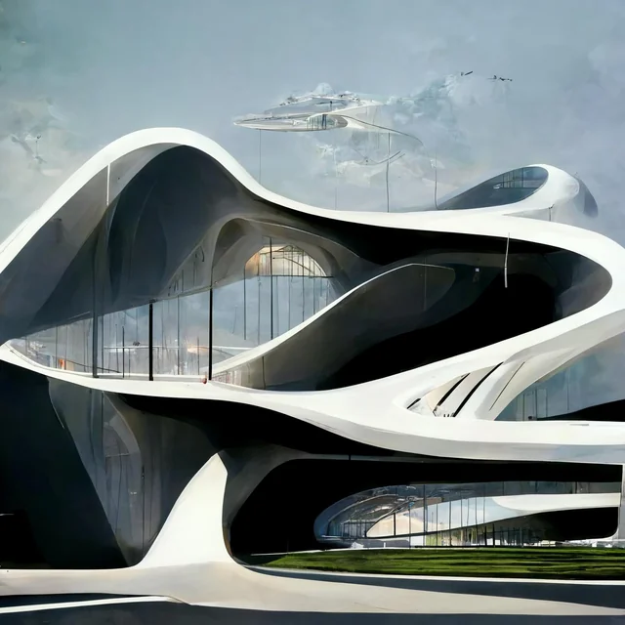
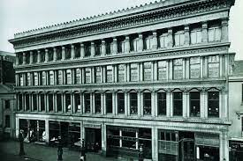
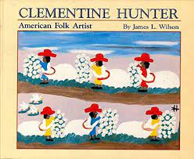
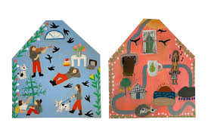
Where I live!
Topic Questions:
Geography: Can you name a traditional type of house from around the world?
History: How did people live in the past compared to today?
Science: What materials were the best to make the house and why?
Music: Can you perform your favourite rhyme?
DT: What is an architect?
Art:What did you use to make your Clementine Hunter?
PSED: What are some symbols of Easter?
DT and Art
Make, making, explain, materials, design, paper, fold, tear, stick, scissors, glue, sellotape, blu-tack, treasury tags, elastic bands, hole punch, hammer, nails, materials, improve, develop, architect, artist,
Clemetine Hunter, snapshot, memories, plantation.
Zaha Hadid
Alexander Thompson
Electricity
Battery, plug, socket, electricity, wire, sound, light, move, mains electricity, device, appliance, electrical safe, danger, energy, rule
Forces
object, float, sink, water, up, down, top, bottom, push, pull, magnet, spring, squash, bend, twist, stretch, turn, spin, smooth, rough, fast, slow
rising, falling, attract, repel, faster, slower,
Materials, including changing materials.
mix, stir, cook, hot, oven, microwave, change, burn, melt, hard, runny, set, freeze, freezer, cold, blended, hard, soft, bendy, stiff, wobbly, wood, plastic, paper, card, fabric, solid, liquid, rigid, stronger, weaker

Slide 2
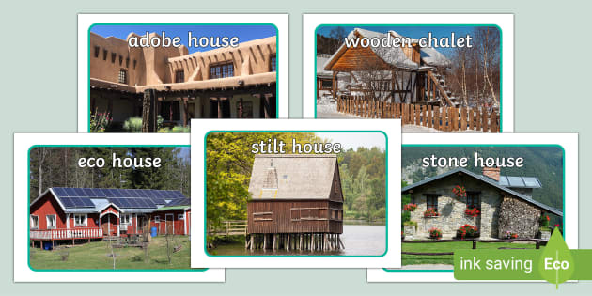
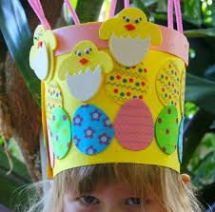
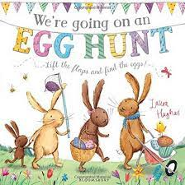
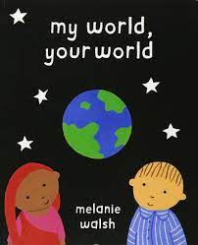
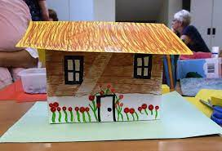
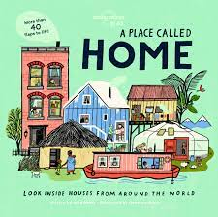
Topic Tasks
Build a house using junk modelling. Bring it in to show your class.
Go on a walk around the village and see old and modern buildings.
Go on a signs of spring walk where you live. What can you see and hear?
Can you perform and share your favourite song?
Design an Easter egg on https://www.bbc.co.uk/cbeebies/joinin/egg-cellent-cbeebies-friends-send-in
Make an Easter hat!
Geography and History:,
Architect, modern, past, present, traditional,
Adobe, mud hut, chalet, houseboat, stilt house, igloo, chum, villa, flat, bungalow, caravan, mansion, treehouse, house
Flat, semi-detached. terraced house, radiator.
PSED:
Easter, Jesus, rebirth, cross, church, Easter story, new life, symbols, plants, spring, Easter eggs, hot cross buns, Palm leaves, Easter, Christian, Holi, Hindu, Muslim.
Make your own house!

