Slide 1

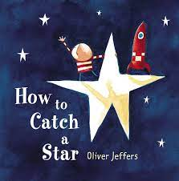
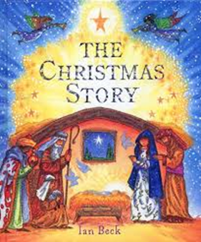
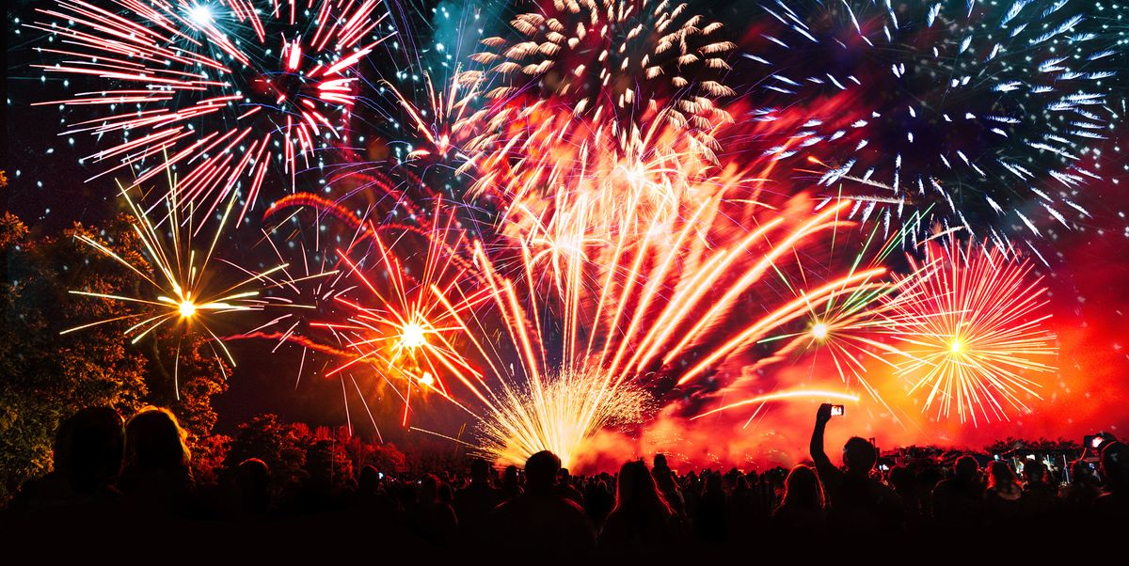
Fun, Fireworks and Food
Topic Questions
Geography: How do people celebrate Christmas in different ways around the world?
History: What is the Christian nativity story about?
Science: What are your 5 senses?
Music: What are the sections in your favourite nursery?
DT: What is a feature of you favourite toy and why do you like it?
Computing: What do you do if something makes you feel uncomfortable online?
Art: How do different colours make you feel?
Vocabulary
Geography and History: Celebration, Church, temple, Christmas,
Science: Light, shadow, torch, see through, not-see-through, source light source, sound, noise, listen, hear, high, loud, volume, Senses- sight, touch, hearing, smell, deaf, blind
Computing: online, offline, uncomfortable, embarrassed, sad, upset, e-safety, 5 trusted adults
DT: evaluate products: spout, plastic, handles, fabric, soles, stitching, grip, elastic, sew, hinge, Lens
Food technology: Clean, germs, cook, bake, stir, mix, healthy, unhealthy, fruit and vegetables names, cut, chop, slice, sieve, safely, cut, peel, spread, ingredients, recipe, roll, stir, pour, roll out, shape, sprinkle, cook
Art: Nursery rhymes, Feelings; happy, sad, excited, nervous, scared

Slide 2
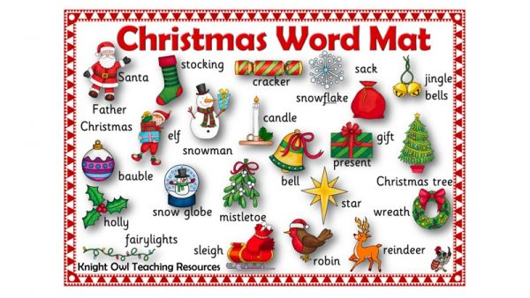
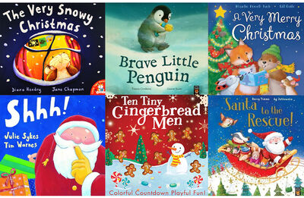
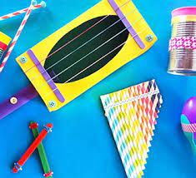
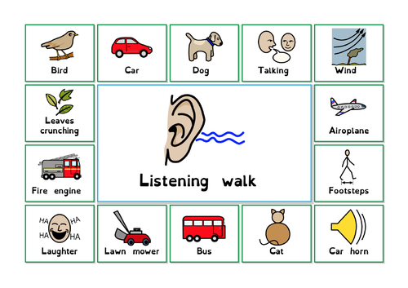
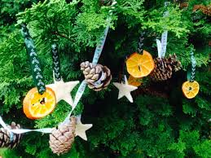
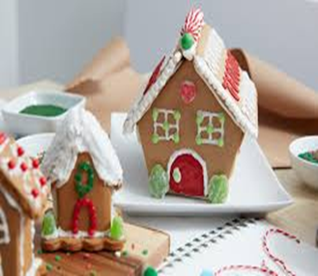
Topic Tasks!
Have fun trying these and post your pictures and videos on to Dojo to share with your class!
1. Can you sing your favourite nursery rhyme?
2. Can you make a prop for your favourite nursery rhyme e.g. a star for ‘twinkle, twinkle little star’
3. Talk about a celebration you have experienced (Christmas/ birthday/ Halloween/Diwali/ bonfire night). How do you celebrate it? Make a poster.
4. Can you bake a Christmas treat?
5. Can you make a Christmas decoration?
6. Can you talk about Autumn and Winter and the changes you have seen?
7. Go in a sound walk and record the different sounds you can hear.
8. Make a musical instrument and play it loudly and quietly
Make a Christmas decoration!
Make a musical instrument!
Go on a sound walk and record what you hear.

