Slide 1
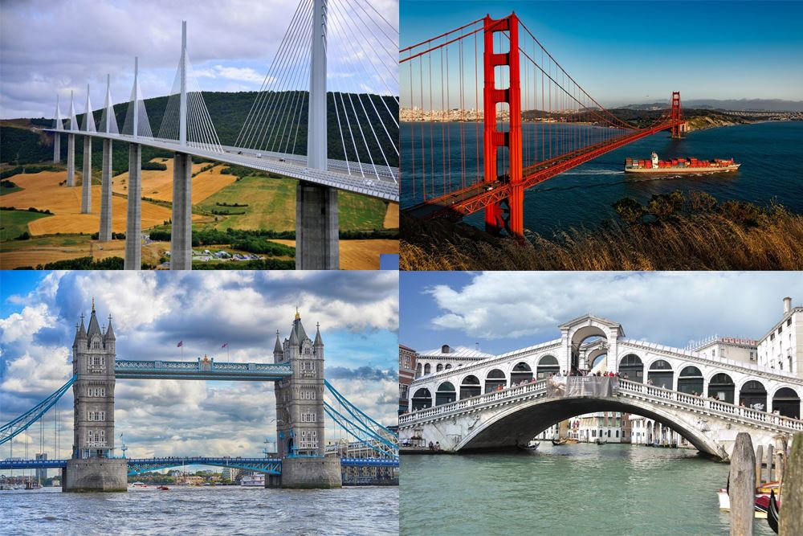
Bounce Wriggle and Crawl.
Recognise some similarities and differences between life in this country and life in other countries
Recognise some environments that are different to the one in which they live.
TOPIC QUESTIONS Can you discuss how some environments are different from the one in which you live? Can you discuss what experiments you did in Science week? How did you make a bridge? Can you share and perform a new song from BigBear Funk? Why is Easter an important celebration? Can you name 3 signs of spring. Why is exercise and movement important and how does your body change when you exercise?

Slide 2
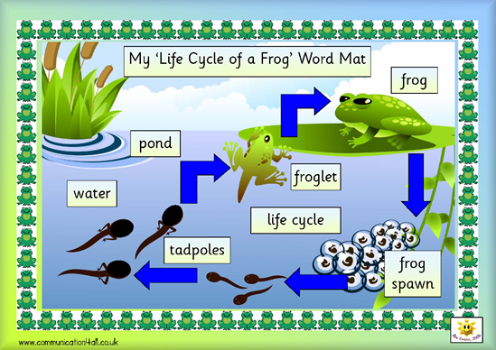
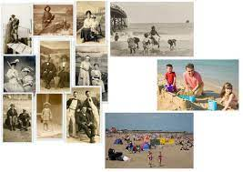
Key Vocabulary
names of animals, live, on land, in water, jungle, desert, antartic, sea, hot, cold, wet, dry, snow, ice
Forces, float, sink, up, down, top, bottom, surface, move, roll, drop, fly, turn, spin, fall, fast, slow, faster, slower, fastest, slowest, further, furthest, wind, air, water, blow, push, pull, magnet, spring, squash, bend, twist, stretch, turn, smooth, rough
Join, fix, plan, draw, measure, strong, weak, stable, on top, underneath, side by side
Comment on images of familiar situations in the past
Identify some similarities and differences between things in the past and now.
Topic Tasks!
Have fun trying these and post your pictures and videos on to class Dojo.
Research an British creature and make a poster about it
Make a bird feeder.
Do some bird spotting- how many birds can you see?
Make your own chocolate eggs/ chocolate egg nests.
Go on a signs of spring spotting walk- how many signs of spring can you find?
Go for a walk around your local area to spot the key landmarks ( the park, church, shop).

