Slide 1
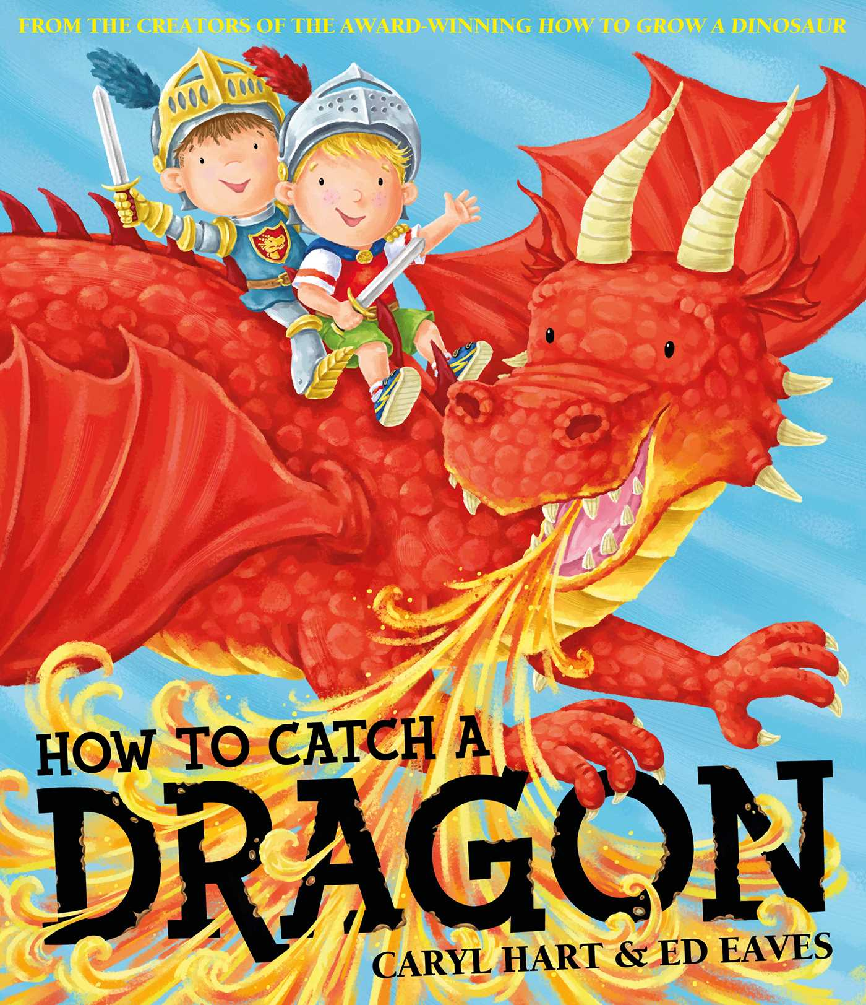
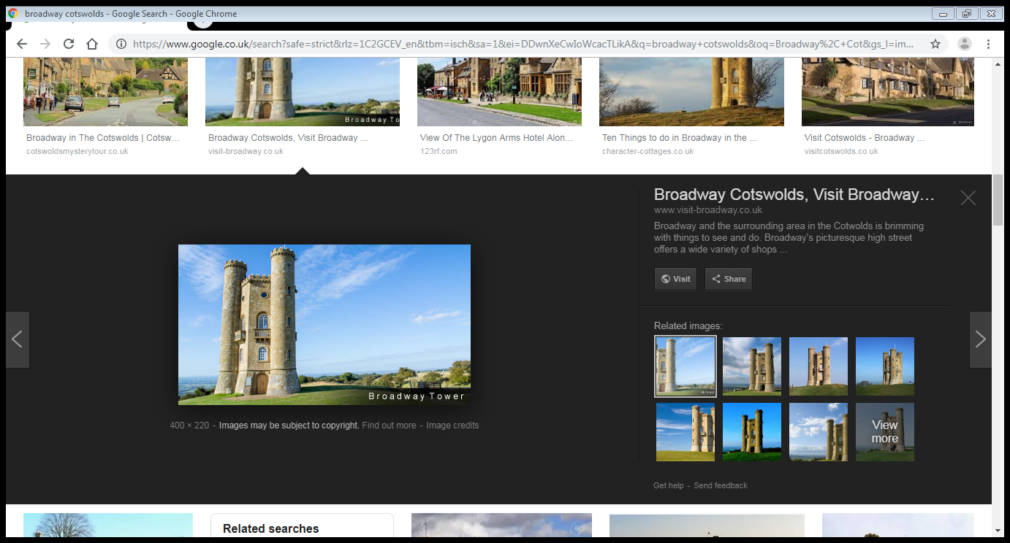
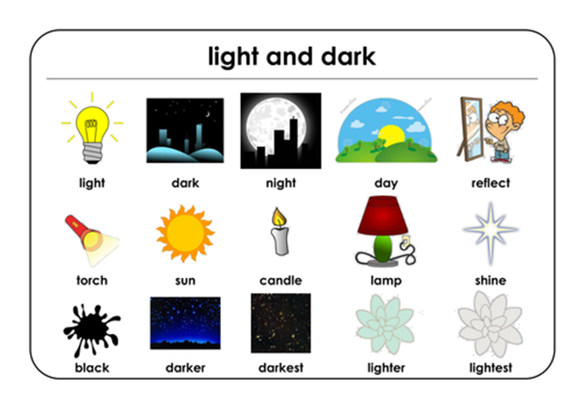
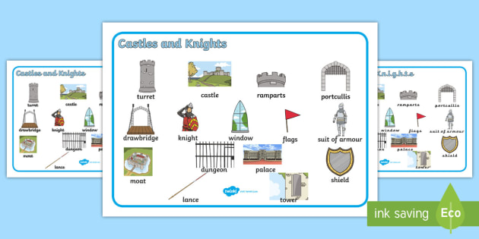
Dragons, Fairies and Knights!
Fairies and Dragons
Warwick Castle
KEY QUESTIONS:
Geography: Who is the King of the United Kingdom?
History: What is a castle?
Science: What is a material light can shine through?
Music: What is a Boomwhacker?
DT: What materials did you use to make your Peg Fairy?
Computing: What is personal information?
Art: What colours are in a rainbow?
Studley Castle
Knights
Broadway Tower
Castles

Slide 2
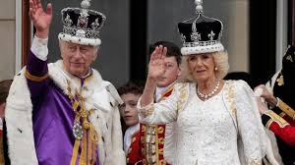
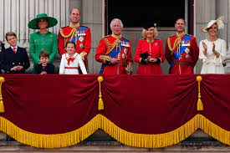
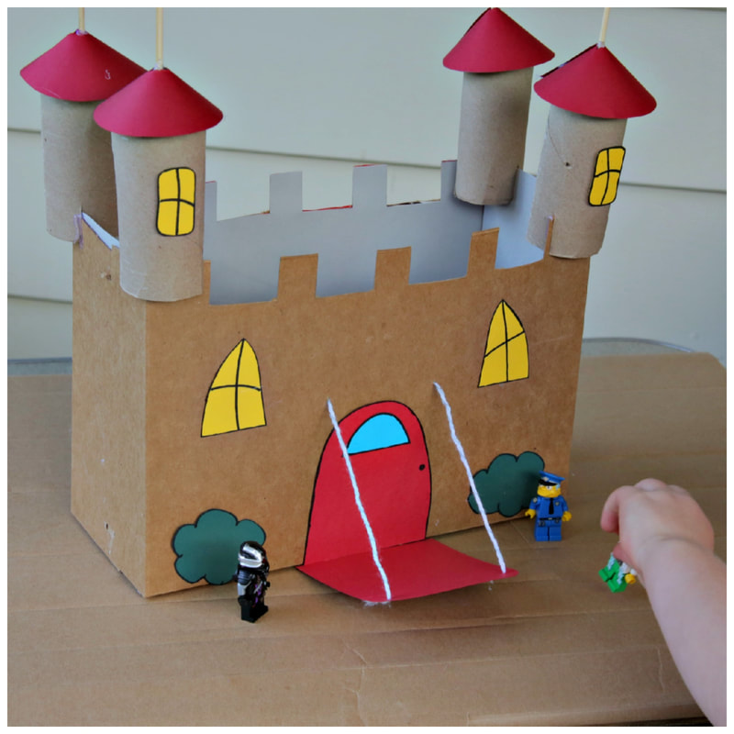

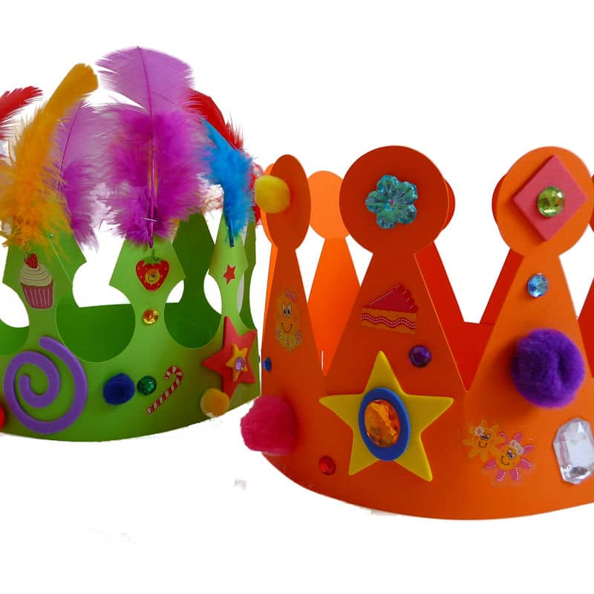
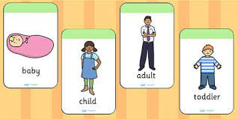
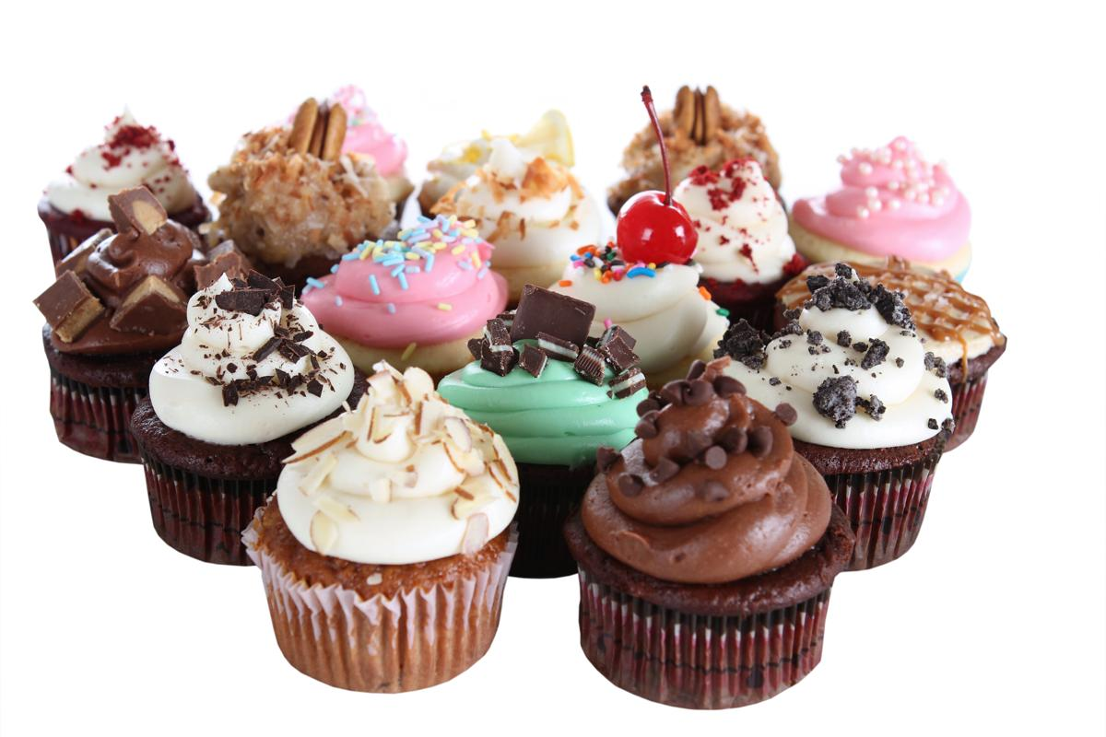
The Royal Family
Topic Tasks!
Take photos/ videos and upload them to class dojo.
We love sharing these with our friends!
Bake fairy cupcakes.
Create an obstacle course in your garden/ living room and pretend to be a knight on an adventure.
Design your own castle using junk modelling- talk about what you have made.
Explore Broadway village and draw a map with your 3 favourite places!
Design your own crown and pretend to be a Queen or King.
Make a poster with pictures of the Royal Family.
Look at some pictures of key landmarks in London- which ones are your favourite? Say why.
What are the school rules?
Have Fun!
King Charles 111 and Queen Camilla
Queen Elizabeth 11
The Royal Family
London
Capital City of
England.

