Slide 1
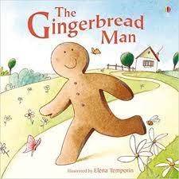
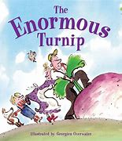
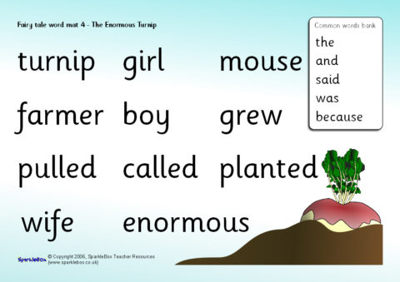
Once upon a time!
In this topic we will be learning some traditional stories and building our bank of story language through these familiar stories. We will be exploring how people celebrate Christmas around the world and how beliefs may differ between cultures. In
Science we will be exploring the world around us through the units of ‘Light’, ‘Sound’ and ‘Humans’. In Expressive Arts and Design, we will be exploring materials to design and make our own winter hats.
Topic Questions
Geography (UTW): Can you talk about how people celebrate special times?
Science (UTW): How have used your senses to explore light and sound?
DT (EAD): How did you make your own hat?
Literacy: Can you re-tell the Gingerbread man story?
Music (EAD): Can you sing your favourite nativity song?

Slide 2
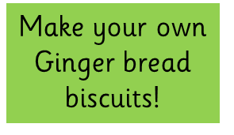
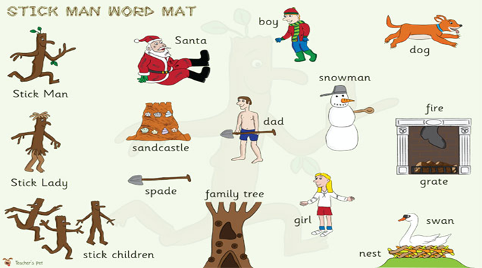
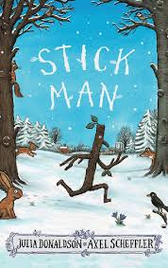
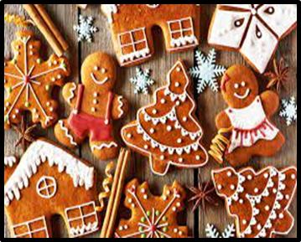
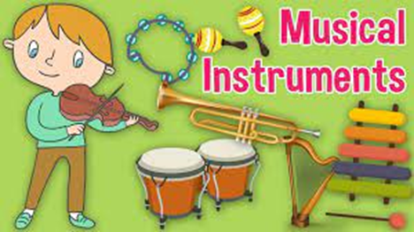
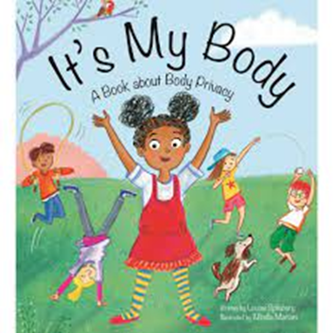
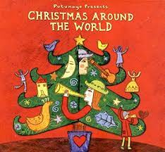
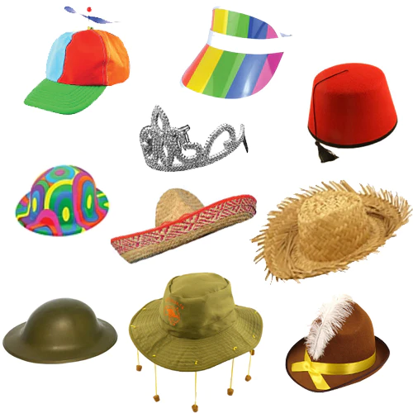
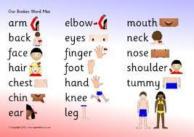
Topic Tasks!
Have fun trying these and show your class!
Make your own gingerbread man biscuits.
Record your favorite nursery rhyme.
Read a traditional tale story.
Build a house for one of your toys using bricks/ lego/ sticks.
Create your own musical instrument and make music to your favorite nursery rhyme.
Dance freely to different festival music .
Make your own stick man.
Create your own Celebration hat!
Let’s explore hats!
Make your own celebration hat!

